Slide 1

溝 通 原 則
Principle of Communication

Slide 2
軟實力
青輔會訪問四五二位企業雇主或人資主管，針對「就業力技能」所做的優先順序排行調查，依序為：
良好的工作態度、穩定度與抗壓性、表達與溝通能力、學習意願與可塑性、專業知識與技術、團隊合作能力、基礎電腦應用技能和主動發覺及解決問題的能力。

Slide 3
定 義
參與成員對所涉及共同性之事物進行意見交換，以達成彼此間之共識。
其進行方向必須是雙向。
強調的是“互動”---參與者在個人的經驗領域內產生與詮釋訊息

Slide 4


Feedback
idea
Encode
Decode
Reception
Transimission
Feedback
Understanding

Slide 5
雙向溝通
信息
回饋
說者與聽者的角色不斷相互轉換。
聽、說、問、答

Slide 6
7 C’S OF EFFECTIVE COMMUNICATION
Control
Conversational
Confident
Competent
Calm
Clear
Concise

Slide 7
Control
Control yourself, your body language, pace, tone, etc., and control the audience or listener. Control the topic and avoid big digresion, control your emotions, control the venue if possible so as to be in a comfortable area and room.

Slide 8
Conversational
Do not lecture, do not whine, do not get angry or over-emotional. keep control and keep it conversational. This means back and forth, active listening, and not getting over-emotional for no good reason. Do not get sucked into an argument that will harm your image later..

Slide 9
Clear
Do not beat around the bush. State exactly what you want people to do, or why they should follow you. Don’t let people guess your meaning. State clearly your objectives or desires, and people will respect you for your leadership and ideas. Please still include the 3Ps(Polite, Professional, Positive) when you deliver your message though.

Slide 10
Concise
Do not waste valuable time. Say what you have to say and ask what you need from your listener or team, and then let them go. When giving suggestions, advice or orders, give them with appropriate details delivered in a short, concise way.

Slide 11
Competent
You have to back it up. Whatever you are saying or selling, be not only prepared but also be able to back it up. You must be good at what you are suggesting others follow you on as well. If you are seeking a leadership role. Why should I listen to you? Answer that question before you meet the group.

Slide 12
Calm
If you start calm, you are more likely to both calm down others and to continue to communicate calmly. Control your breathing, pace, volume, etc. in a relaxed way. Use rhythmic gestures as well. Noting fast and darting. Think Yoga movements!

Slide 13
Confident
People are less likely to challenge you and more likely to follow you if you present yourself with confidence. Your voice should be loud enough and at a controlled pace, your body language should be strong with a straight back, meaningful gestures, great eye contact, etc. And the content of your presentation or point to be made should also come from a confident place.

Slide 14
COMMUNICATING CORE IN BUSINESS
Respecting Time
Empathy
Skilled Listening
Problem Solving
Etiquette
Choice of Medium
Tone

Slide 15
Respecting Time
Respond in a timely manner.
­ E-mails and phone calls within 24 - 48 hours.
Response can even be a quick, “I will look into it.”
Try your best not to be late. It implies that other things are more important than their time.
­Web conferences arrive 10 minutes beforehand.

Slide 16

Empathy
Notes:
Reasoning: Understand another person's thoughts, feelings, reactions, concerns, motives.
Stop and think for a moment about the other person's perspective; understand where they are coming from.
Emotions: Care for that person's concern.
Caring does not mean that we agree or change our position.
Be in tune with what that person is going through, so we can respond in a way that acknowledges their thoughts, feelings or concerns

Slide 17
Skilled Listening
Pay attention and be present
Listen actively and intently Do not interrupt people when they’re speaking
Put everything in writing as much as possible following conversations
Don’t be afraid to ask questions

Slide 18
Problem Solving
Try to make each conversation helpful
It can able controlled with your reaction
Be able to admit when you’ve made a mistake
There is a time and place for a confrontation

Slide 19
Etiquette
Use Please and Thank You
Try not to not criticize others, unless constructively and with a suggestion
­Dress for success ­ Work e-mails, calls and meetings should not be like personal e-mails, calls or meetings.
Respect people's personal space. This may be very different than your own

Slide 20
Etiquette(2)
Don't make value judgments on people's importance in the workplace
Don’t gossip
Avoid the “Big two”, Politics and Religion
Like it or not, other people’s opinions matter in business

Slide 21
Choice of Medium
It is okay to respond using the medium where it originated.
Choose the method that gets best response from recipient after you have gotten to know them.
Letters are still viable. Especially “Thank You” letters.
Don’t use e-mail as an excuse to avoid personal contact. Don't forget value of face-to-face or voice-to-voice communication.
Phone calls and in-face help convey emotion and are great for conflict resolution.
Don't use e-mail to avoid an uncomfortable situation or to cover up a mistake.
Don't e-mail or call angry. Cool off

Slide 22
Tone
Tone comes across in all mediums.
Avoid "provoking" words that put people on the defensive such as, "Why did you...," "You must...," and "I don't understand your..."
Avoid condescension. No one wants to feel belittled

Slide 23
交動模式
強調人際溝通的動態與人們在過程中擔負的多重角色
包含了時間的特質---溝通中的訊息、噪音與經驗領域都會隨時間而改變
面對新事物或擴展自我經驗時，改變與他人的互動

Slide 24
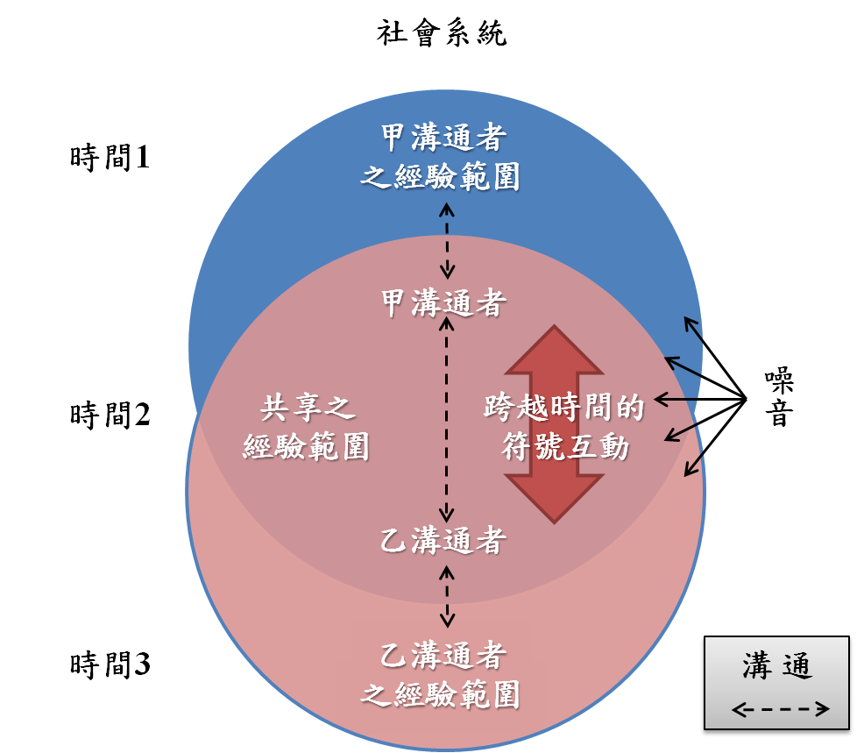

Slide 25
人際溝通的特徵
定義為選擇性、系統性、個人性與過程(一個持續的過程)的互動，使得人們得以思考與建立彼此的個人知識並產生分享的意義

Slide 26
系統性
所有溝通發生在影響意義的多重系統中
部分或所有系統(情況、時間、人物、文化與個人背景等因素)都相互作用影響意義
所有系統都可能有噪音障礙存在

Slide 27
溝通種類
溝通
語言
非語言（面部表情）
語言 文字
聲音
語氣
肢體
語言
身體
動作

Slide 28
影響因素
情境
  物理的
  社會的
  歷史的
  心理的
  文化的
參與者
訊息
管道
干擾
回饋

Slide 29
溝 通 八 大 問
詞句與理念/經驗一致？
字眼能否感同身受？
造成對方不解之障礙？

Slide 30
NOISE
外部障礙
  語義障礙
    文字多意、 一語多關
    地域差異
    字意演 變
    比較性錯覺
  階層/角色障礙
  語音障礙

Slide 31
內部障礙﹝意識型態﹞
  Exposure Filter
  Perceptive Filter
  Retention Filter
  Experience Filter
  Personal Filter
  Age
  Sex
  Race/Religion Filter

Slide 32


Slide 33
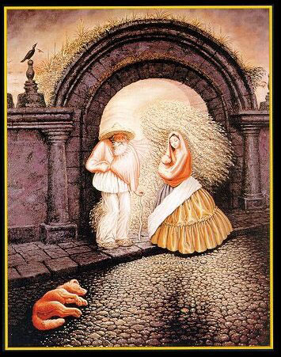

Slide 34
溝通八大問﹝續﹞
對方是否了解內容？
是否滿足對方需求？
何事物阻斷對方持續溝通？
溝通媒介之影響？
現代科技之影響？

Slide 35
溝 通 十 大 障 礙
生理障礙
物理(環境)障礙
文化障礙
經驗障礙
認知障礙

Slide 36
溝通十大障礙﹝續﹞
心理障礙
階層障礙
語意障礙
非語言障礙
競爭障礙

Slide 37
原則
不溝通之不可能
溝通發生不可逆
溝通涉及倫理抉擇
人們在溝通中建構意義
眉它溝通(Metacommunication)影響意義
溝通非萬靈丹
溝通效能可以學會
Notes:
Metacommunication另一種溝通的形式，很少能被意識到 。後設溝通是指在語言及非語言溝通的進行中，個體對彼此的角色期待（role expectation），這些角色期待會強烈地影響語言及非語言溝通的本質。譬如，當銷售員對顧客說：「我可以幫助你嗎？」雙方都了解這是在問是否可以幫助顧客購買某物。換句話說，當診療室的護理人員問相同的問題，患者與護理人員都了解，他在問是否他可以做什麼，諸如聽或基於患者需要予以協助。

